Slide 1

INFO 6105 – Data Science Engineering Methods & Tools
Final Project: Spotify Music Prediction Algorithm
Team Members:
1. Aditya Mulik
2. Tushar Kurhekar

Slide 2

Spotify Music Prediction Algorithm
Purpose of the Model?
To identify the popularity of a track using the track's attributes
This Photo by Unknown author is licensed under CC BY.

Slide 3
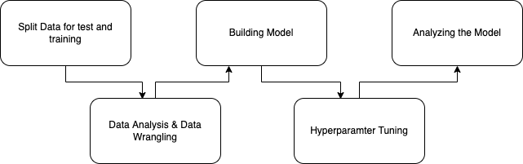
Machine Learning Journey

Slide 4
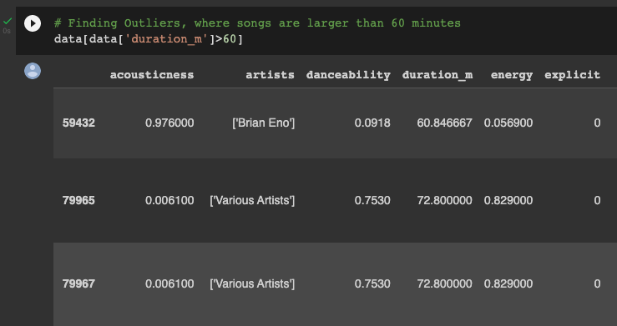
Data Analysis & Wrangling
We have sorted data by popularity of music
Converting the music duration to minutes
Identifying outliers such as music which are larger than an hour (Attached Screenshot)

Slide 5
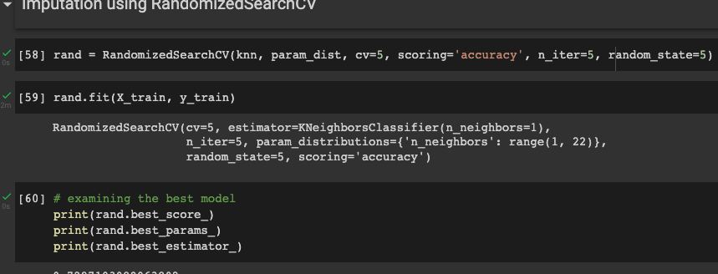
Model - Hyperparameter Tuning
We have tuned the model by hyperparameter tuning with the best possible solution for KNN Classification models
Here the tool used in RandomizedSearchCV

Slide 6

Conclusion
We trained our model, performed hyperparamter tuning and KNN classification model was the best fit for this type of data which received an accuracy score of approximately 74% which ensures no overfitting or underfitting of data.

Slide 7

Thank You

